Slide 1
SMART INDIA HACKATHON 2019 GRAND FINALE PRESENTATION ON Smart parking with smart tap
Presented by:-
Kajal Verma (leader) ANURAG SONI
ADARSH MEHTA Richa Vishwakarma
sIMRANJEET KAUR

Slide 2
Problem statements
Average individual spend 5-7min for finding parking spots.
Late response to users when in need during emergency situation.

Slide 3
Workable Solution
Components :
Raspberry Pi
IR Sensors
LEDs
Survo Motor
RFID
Jumpers
Solutions:
Providing an android app to book parking slot using RFID tags
Ease of parking
Sending last updated location of the user when in trouble

Slide 4
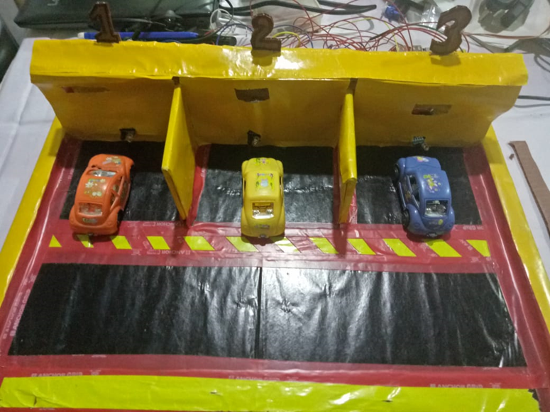
Working theory
The user will book the slot of his or her choice and also in case of emergency the user can notify the desired persons through offline sms service.
Once the person reaches the destination the admin panel will guide the user with the help of rfid tag system , once the sensor detects the car the status will be updated in the firebase using raspberrypi .
Firebase is a real time database of google cloud ,it works as an intermediator between frontend and backend.

Slide 5
Business model
ESTIMATION FOR 100 VEHICLES
Sno. | SMART PARKING SYSTEM |  |  |  | TRADITIONAL PARKING MECHANISM
 | ITEMS | PRICE | QUANTITY | AMOUNT | PRICE | QUANTITY | AMOUNT
1 | Sensors | 300 | 100 | 30000 | 300 | 0 | 0
2 | Wiring | 10 | 100 | 1000 | 10 | 0 | 0
3 | Servo | 150 | 100 | 15000 | 150 | 0 | 0
4 | Raspberry Pi | 3000 | 4 | 12000 | 3000 | 0 | 0
5 | Bulbs | 200 | 10 | 2000 | 10 | 0 | 0
6 | Stationaries | 0 | 0 | 0 | 5000 | 1 | 5000
7 | Manpower | 10000 | 1 | 10000 | 10000 | 5 | 50000
TOTAL |  |  |  | 70000 |  |  | 55000

Slide 6
conclusion
Booking facilities
Efficient space & time management
Database robustness & reliability
Panic application
Offline features(panic messages)
GPS api
Fair fare charges

Slide 7
THANK YOU

